Slide 1
This is CS50

Slide 2
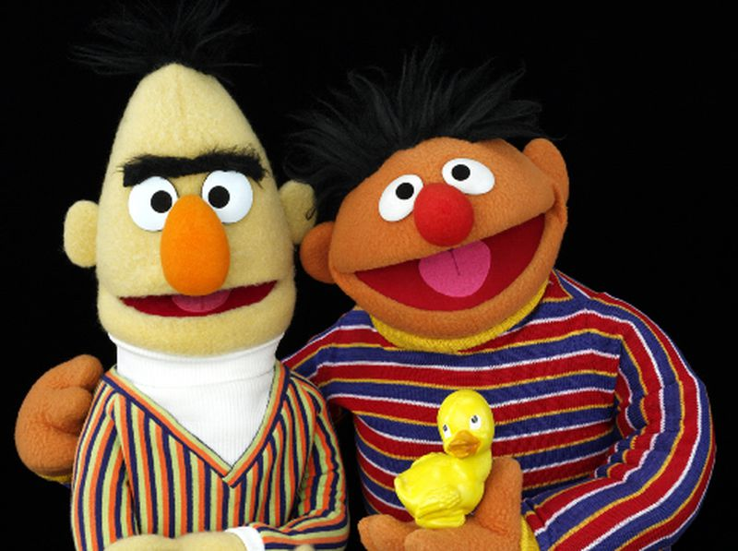
Notes:
https://www.nydailynews.com/entertainment/tv-movies/online-push-bert-ernie-gay-wedding-sesame-street-article-1.947839

Slide 3
This is CS50

Slide 4
internet

Slide 5
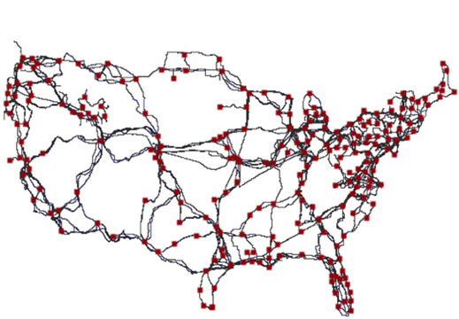
Notes:
https://www.technologyreview.com/2015/09/15/166239/first-detailed-public-map-of-us-internet-backbone-could-make-it-stronger/

Slide 6
TCP/IP

Slide 7

clkr.com

Slide 8
IP

Slide 9
DNS

Slide 10
TCP

Slide 11
80 HTTP
443 HTTPS
...

Slide 12
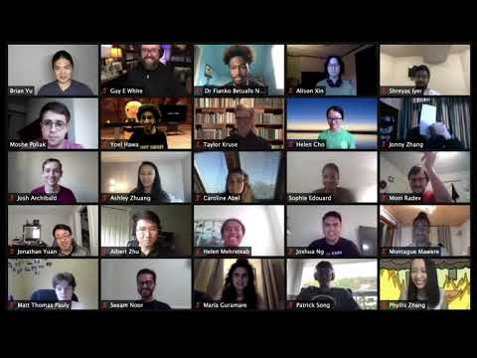

Slide 13
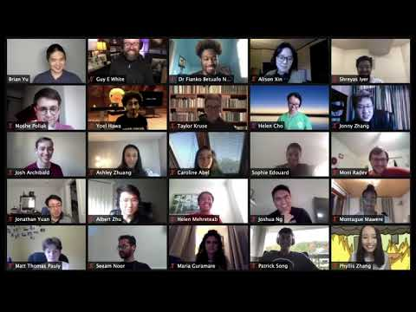

Slide 14
HTTP

Slide 15
GET
POST
...

Slide 16
https://www.example.com/index.html

Slide 17
https://www.example.com/index.html

Slide 18
https://www.example.com/index.html

Slide 19
https://www.example.com/index.html

Slide 20
https://www.example.com/index.html

Slide 21
https://www.example.com/index.html

Slide 22
https://www.example.com/index.html

Slide 23
HTTP

Slide 24
GET / HTTP/1.1
Host: www.example.com
...

Slide 25
GET /index.html HTTP/1.1
Host: www.example.com
...

Slide 26
HTTP/1.1 200 OK
Content-Type: text/html
...

Slide 27
GET / HTTP/1.1
Host: www.harvard.edu
...

Slide 28
HTTP/1.1 301 Moved Permanently
Location: https://www.harvard.edu/
…

Slide 29
HTTP/1.1 404 Not Found
Content-Type: text/html
...

Slide 30
200 OK 301 Moved Permanently 302 Found 304 Not Modified 307 Temporary Redirect 401 Unauthorized 403 Forbidden 404 Not Found 418 I'm a Teapot 500 Internal Server Error 503 Service Unavailable ...

Slide 31
GET / HTTP/1.1
Host: safetyschool.org
...

Slide 32
GET / HTTP/1.1
Host: www.harvardsucks.org
...

Slide 33
GET /search?q=cats HTTP/1.1
Host: www.google.com
...

Slide 34
HTML

Slide 35
tags
attributes

Slide 36
<!DOCTYPE html>
<html lang="en">
<head>
<title>
hello, title
</title>
</head>
<body>
hello, body
</body>
</html>

Slide 37
<!DOCTYPE html>
<html lang="en">
<head>
<title>
hello, title
</title>
</head>
<body>
hello, body
</body>
</html>

Slide 38
<!DOCTYPE html>
<html lang="en">
<head>
<title>
hello, title
</title>
</head>
<body>
hello, body
</body>
</html>

Slide 39
<!DOCTYPE html>
<html lang="en">
<head>
<title>
hello, title
</title>
</head>
<body>
hello, body
</body>
</html>

Slide 40
<!DOCTYPE html>
<html lang="en">
<head>
<title>
hello, title
</title>
</head>
<body>
hello, body
</body>
</html>

Slide 41
<!DOCTYPE html>
<html lang="en">
<head>
<title>
hello, title
</title>
</head>
<body>
hello, body
</body>
</html>

Slide 42
<!DOCTYPE html>
<html lang="en">
<head>
<title>
hello, title
</title>
</head>
<body>
hello, body
</body>
</html>

Slide 43
<!DOCTYPE html>
<html lang="en">
<head>
<title>
hello, title
</title>
</head>
<body>
hello, body
</body>
</html>

Slide 44
<!DOCTYPE html>
<html lang="en">
<head>
<title>
hello, title
</title>
</head>
<body>
hello, body
</body>
</html>

Slide 45
<!DOCTYPE html>
<html lang="en">
<head>
<title>
hello, title
</title>
</head>
<body>
hello, body
</body>
</html>

Slide 46
<!DOCTYPE html>
<html lang="en">
<head>
<title>
hello, title
</title>
</head>
<body>
hello, body
</body>
</html>

Slide 47
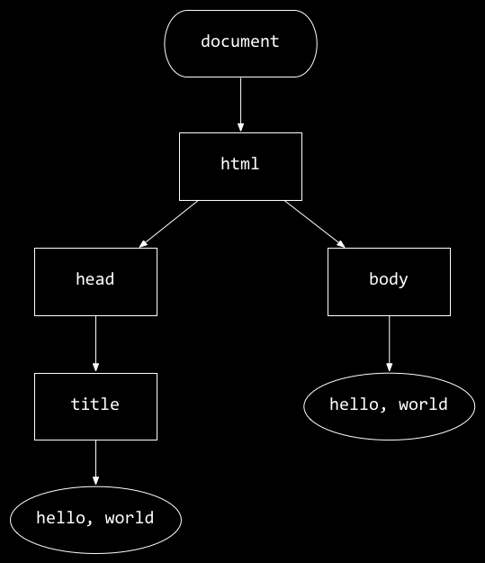
<!DOCTYPE html>
<html lang="en">
<head>
<title>
hello, title
</title>
</head>
<body>
hello, body
</body>
</html>
hello, body
hello, title

Slide 48
CSS

Slide 49
properties

Slide 50
type selectors
class selectors
ID selectors
...
Notes:
https://developer.mozilla.org/en-US/docs/Web/CSS/CSS_Selectors

Slide 51
<!DOCTYPE html>
<html lang="en">
<head>
<title>
hello, title
</title>
</head>
<body>
hello, body
</body>
</html>

Slide 52
<!DOCTYPE html>
<html lang="en">
<head>
<style>
</style>
<title>
hello, title
</title>
</head>
<body>
hello, body
</body>
</html>

Slide 53
<!DOCTYPE html>
<html lang="en">
<head>
<link href="styles.css" rel="stylesheet">
<title>
hello, title
</title>
</head>
<body>
hello, body
</body>
</html>

Slide 54
validator.w3.org

Slide 55
JavaScript

Slide 56
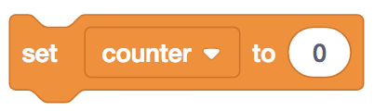
let counter = 0;

Slide 57
let counter = 0;

Slide 58

counter = counter + 1;

Slide 59
counter = counter + 1;

Slide 60
counter += 1;

Slide 61
counter++;

Slide 62
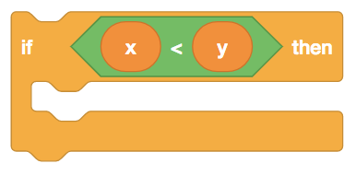
if (x < y) {
}

Slide 63
if (x < y) {
}

Slide 64
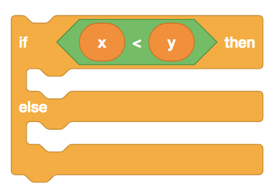
if (x < y) {
}
else
{
}

Slide 65
if (x < y) {
}
else
{
}

Slide 66
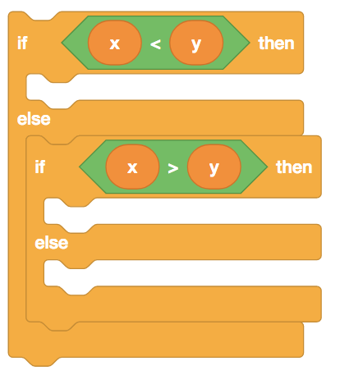
if (x < y) {
}
else if (x > y)
{
}
else
{
}

Slide 67
if (x < y) {
}
else if (x > y)
{
}
else
{
}

Slide 68
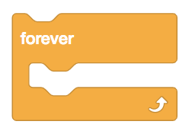
while (true)
{
}

Slide 69
while (true)
{
}

Slide 70
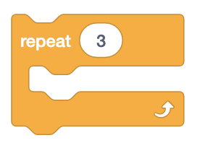
for (let i = 0; i < 3; i++)
{
}

Slide 71
<!DOCTYPE html>
<html lang="en">
<head>
<title>
hello, title
</title>
</head>
<body>
hello, body
</body>
</html>
hello, body
hello, title

Slide 72
<!DOCTYPE html>
<html lang="en">
<head>
<title>
hello, title
</title>
</head>
<body>
hello, body
</body>
</html>

Slide 73
<!DOCTYPE html>
<html lang="en">
<head>
<script>
</script>
<title>
hello, title
</title>
</head>
<body>
hello, body
</body>
</html>

Slide 74
<!DOCTYPE html>
<html lang="en">
<head>
<title>
hello, title
</title>
</head>
<body>
hello, body
<script>
</script>
</body>
</html>

Slide 75
<!DOCTYPE html>
<html lang="en">
<head>
<title>
hello, title
</title>
</head>
<body>
hello, body
<script src="scripts.js"></script>
</body>
</html>

Slide 76
blur change click drag focus keyup load mousedown mouseover mouseup submit touchmove unload ...

Slide 77
This is CS50

